Slide 1


Slide 2


INTELLIGENT ASSISTANCE

Slide 3

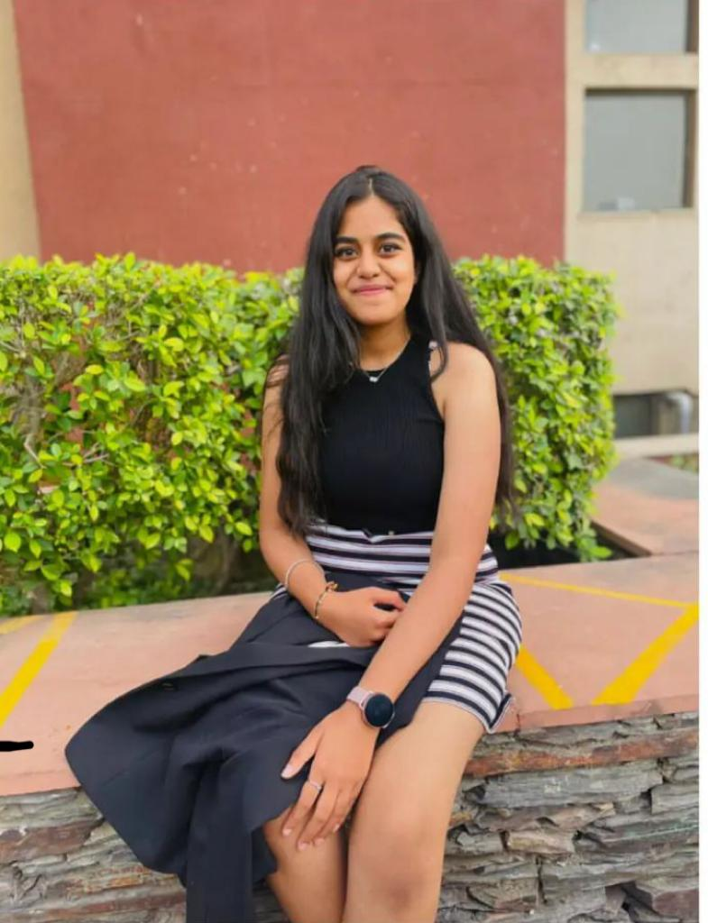

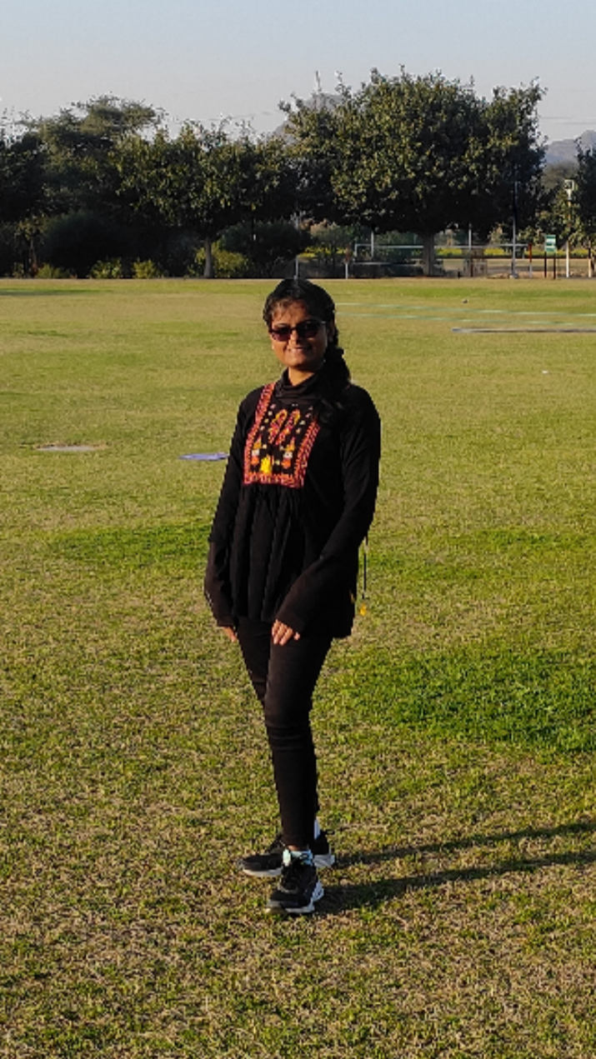


OUR TEAM
Aniket Sandhuja
Geetali Guglani
Nisha Shah
Sanjay Saini
Tanya Varshney

Slide 4
WHERE IS THE GAP?
Brands have come up with features like learning with AI, nanny cam to monitor, and soft toys to play with but don't have any option that is all under one roof.

Slide 5
SOLUTION
Provide a parallel space with learning, entertainment, and safety.
Providing a fun and interactive way for kids to learn while allowing parents to monitor their child's progress remotely.

Slide 6

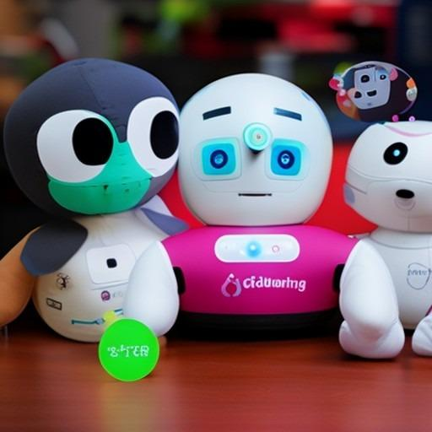
*AI-Generated Design*
Vision - to provide unparalleled entertainment
And education experience and safety monitoring facilities.

Slide 7
SWOT ANALYSIS
Child friendly
Emotional recognition
Tracks growth
Location access
AI adaptive learning
Works on Wifi
Costly in nature
Possibility of errors with AI
S
W
Expands product line with growth in AI
Personalized learning options
Expansion into international markets
0
T
Competition from established brands
Security concerns
Changes in technology

Slide 8
PRODUCT OFFERINGS
Emotional Recognition Technology
Motion detection
Durability

Slide 9
Durability
Emotional Recognition Technology
Motion detection
The product stands to be long lasting and damage free even if used in extreme behaviour of the child
Analyse with ML algorithms to understand the child’s expressions tone, and other non-verbal cues to understand the mood and provide comfort.
Detects movements, and also provides location information & provides added security by alerting in case of any abnormalities

Slide 10










PRODUCT OVERVIEW
Voice
Recognition
Durability
Nanny Cam
Emotional Recognition Technology
Motion
Detection
Safe and
Non-Toxic
Soft and Cuddly Material
Wireless
Connectivity
Educational
Content

Slide 11
MARKET APPROACH
SEGMENTATION
TARGETING
POSITIONING

Slide 12

SEGMENTATION
The main segment lies in the urge to use technology to get knowledge alongside having fun.
DEMOGRAPHICS
PSYCHOGRAPHIC
GEOGRAPHIC
(a)Age -
Kids ( 4-10 )
Parents ( 25- 35 )
(b)Income -
Upper middle class
Upper class
(a)Lifestyle -
Working Parents
Tech savvy
Kids who love to learn
(b)Social status
Launched in: India
Focusing on: Tier 1 cities
Bangalore
Delhi NCR
Mumbai
Chennai
Hyderabad
Ahmedabad, etc.

Slide 13

TARGETING
INDUSTRIAL SECTOR
Education industry
Toy industry
Technology Industry
Childcare industry
PARENTS
Tech-savvy
Convenience-seeking
Safety-conscious parents
High standard of living
INCOME LEVEL
Upper middle class
Upper class

Slide 14

POSITIONING
Promote cognitive development and early learning advantages for children with our fun and engaging educational tool.
Ensure your child's safety during playtime with our AI-powered product featuring motion detection and voice recognition.
Foster an emotional connection between your child and their companion toy with our AI-powered features
Monitor and interact with your child remotely using our wireless connectivity and mobile app for convenient peace of mind.

Slide 15
OUR COMPETITORS
 | MIKO ROBOT | HELLO BARBIE | NOVIE ROBOT | V TECH | LEAP FROG | OPERATOY
Gender neutral | ✅ | ❌ | ✅ | ✅ | ✅ | ✅
Levels of learning | ❌ | ❌ | ❌ | ✅ | ✅ | ✅
Safe to play | ❌ | ✅ | ❌ | ❌ | ❌ | ✅
Receptive in nature | ❌ | ✅ | ✅ | ❌ | ❌ | ✅

Slide 16
OUR COMPETITORS
Measure growth | ❌ | ❌ | ❌ | ✅ | ✅ | ✅
Easy to use | ❌ | ✅ | ❌ | ✅ | ✅ | ✅
Soft and cuddly material | ❌ | ❌ | ❌ | ❌ | ✅ | ✅
Emotional recognition | ❌ | ❌ | ❌ | ❌ | ❌ | ✅

Slide 17
USER PROFILE
Buying decision process
Decision
Criteria
Need Problem recognition
Information Sources
Evaluation of the product & alternatives
Purchase decision
Post purchase behaviour
Who Makes
the decision
Price
Accessibility
Child friendly
Growth level
LIfestyle
Parents
Who are looking for convenience
Tech savvy
High income earning families
Maintaining social status

Slide 18




DISTRIBUTION CHANNEL
Retailer
INTERMEDIARY ANALYSIS
Producer
Consumer
1. Production
Manufacturer
Quality Control
2. Distribution
Retailers
Logistics
3. Marketing
Advertising agencies

Slide 19


FINANCIALS
https://docs.google.com/spreadsheets/d/1GZt8gZXZdVP_PqZpvDy5Knob3uttl6aOkinCnUqdACA/edit?usp=sharing

Slide 20
PROMOTIONAL MIX
TELEVISION
ONLINE
PRINT
SOCIAL MEDIA
RADIO
GUERILLA
MARKETING
WORD OF MOUTH

Slide 21
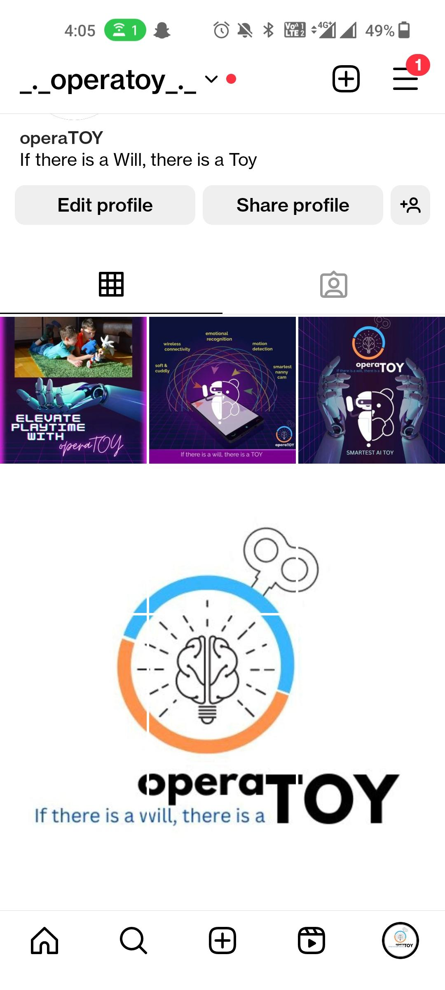
SOCIAL MEDIA

Slide 22
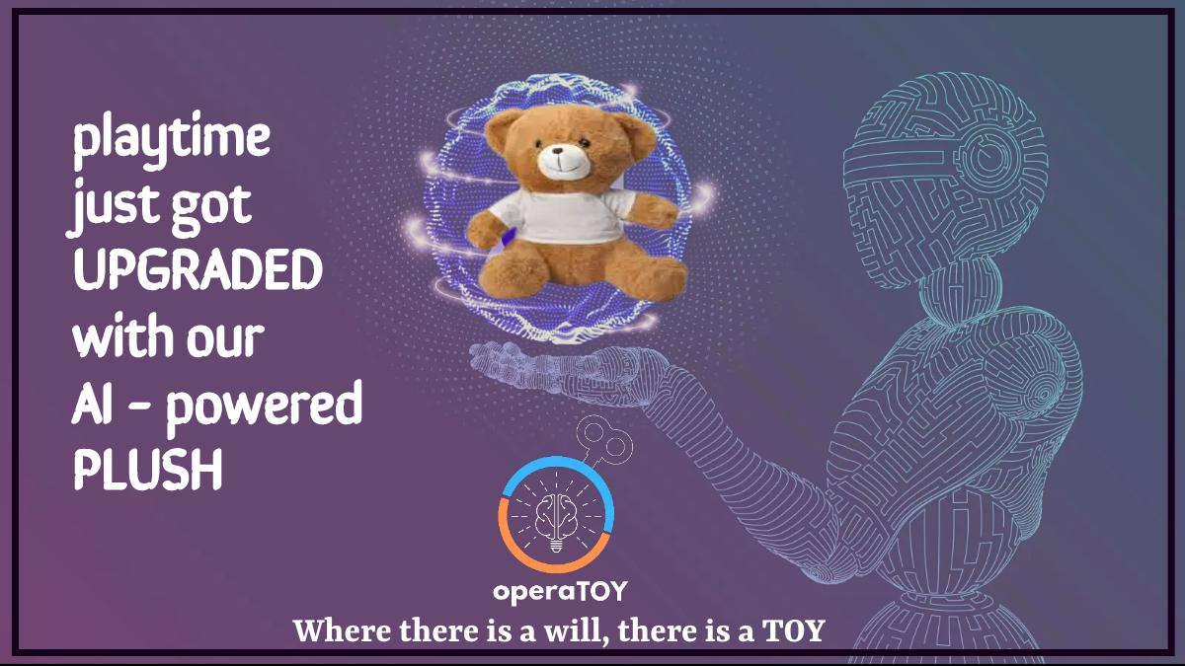
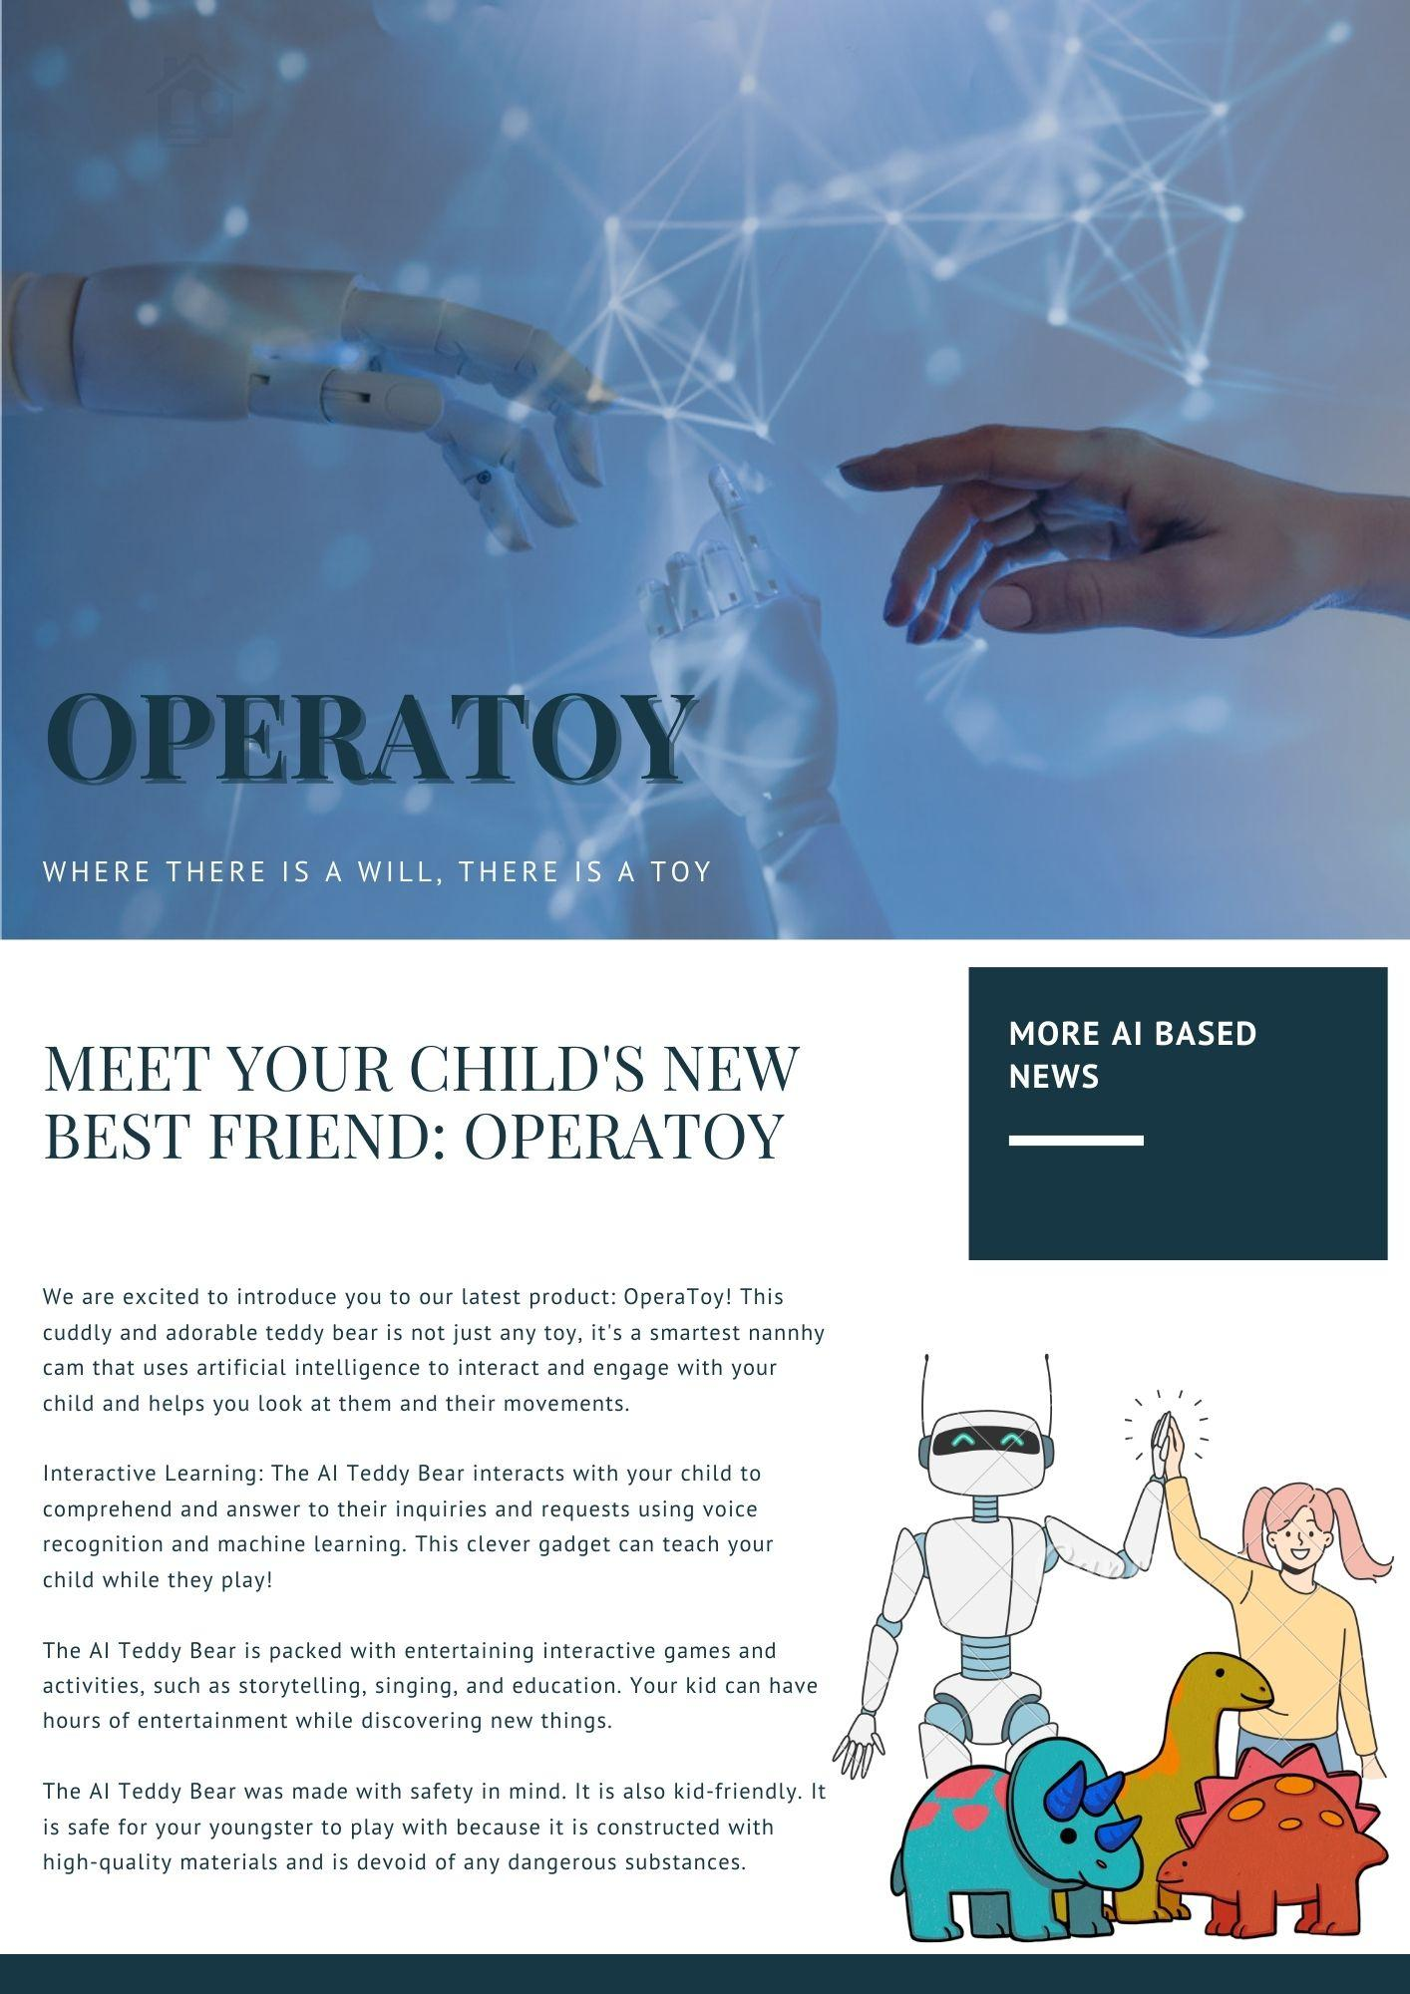
PRINT ADS

Slide 23
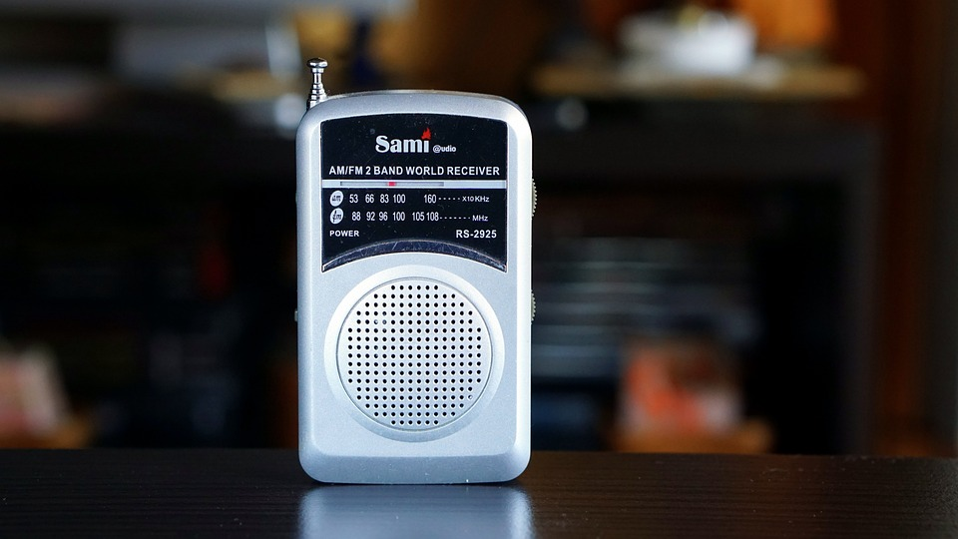

RADIO ADS

Slide 24
TVCs AD

Slide 25

Q & A
SESSION

